Slide 1
Philly
Pawsabilities
By Jody Diamond, Charlie Evert & Danielle Kelly

Slide 2
Not ENOUGH Philly ANIMAL REscuES!
West & North Philadelphia don’t have many, and currently 7% of rescues are euthanized due to a lack of space

Slide 3
...But we can rescue them
1
2
3
4
Intro
Situation
Marketing Planning
Implementation
The Pawsabilities of saving household pets
Who, What, Where & Why
Timelines → Logistics
Product, Price, Place & Promotion

Slide 4
1
intro
Why Philly needs more Pawsabilities

Slide 5

intro
Philly has thousands of stray and abused animals
Animal rescues are low budget options for addressing this travesty
With Covid cheapening rents, animal rescues could expand limitlessly

Slide 6
our
history
We haven’t opened, but we are founded by ambitious SJU MBA students that will get the job done!

Slide 7

Mission, Vision, Objectives
Save Animals’ lives!
Eliminate the need for euthanized animals in Philadelphia!
Expand marketing footprint quickly!

Slide 8
2
Situation
All the W’s

Slide 9
SWOT
Strengths
Opportunities
Weaknesses
Threats
Motivated staff & available capital
7% of Animals are Euthanized & can be saved
No current location & minimal employees
Erosion of working capital & breeder competition

Slide 10
SocioCultural &
Economic Factors
Sociocultural
Economic
Animal cruelty is universally shunned & volunteers should be plentiful as a result
Animal adoptions skyrocketed during pandemic & crowdfunding should be plentiful

Slide 11
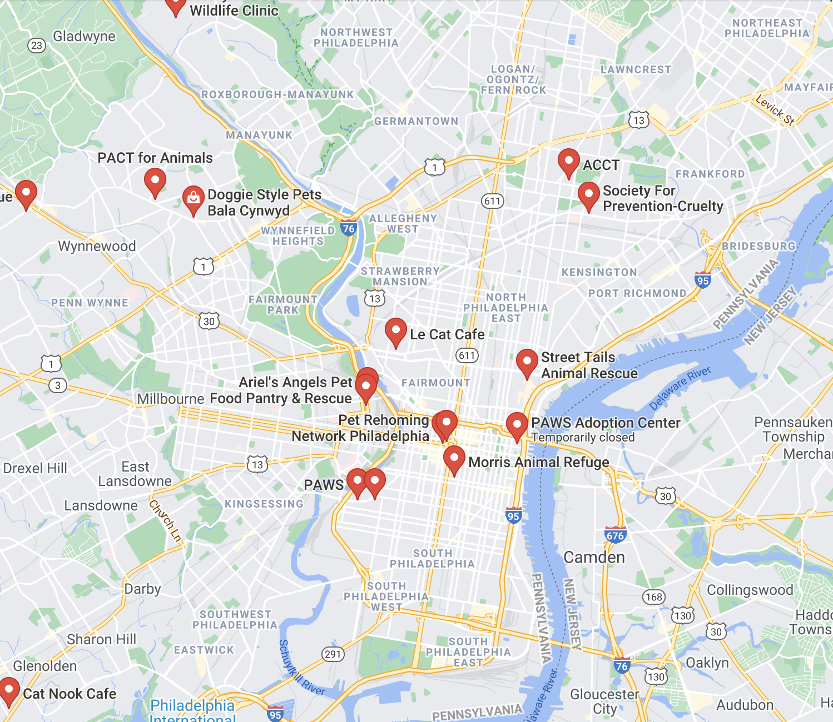
Where should we Rent?
North & West Philly need rescues ASAP
Good locations marked with a

Slide 12
3
Marketing Planning
All the P’s

Slide 13
Product, Price,
Place, Promotion
Price
Product
Promotion
Place
Foster household animals, coordinate rescues
Combine digital & print advertising; aggressively network via social media
Cheap adoptions!
$60 → $250
Focus on renting in North & West Philly → Exchange rescues with other Philly rescues

Slide 14
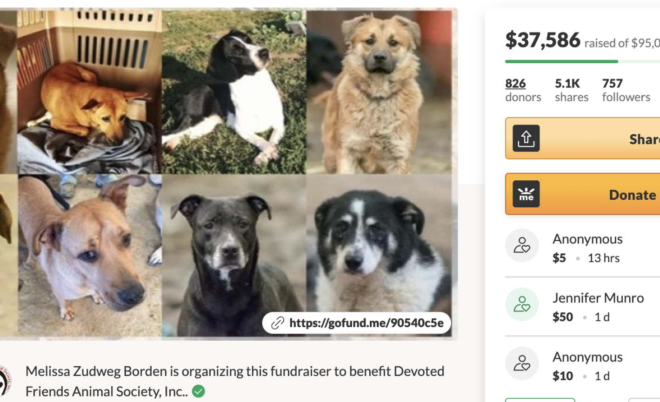
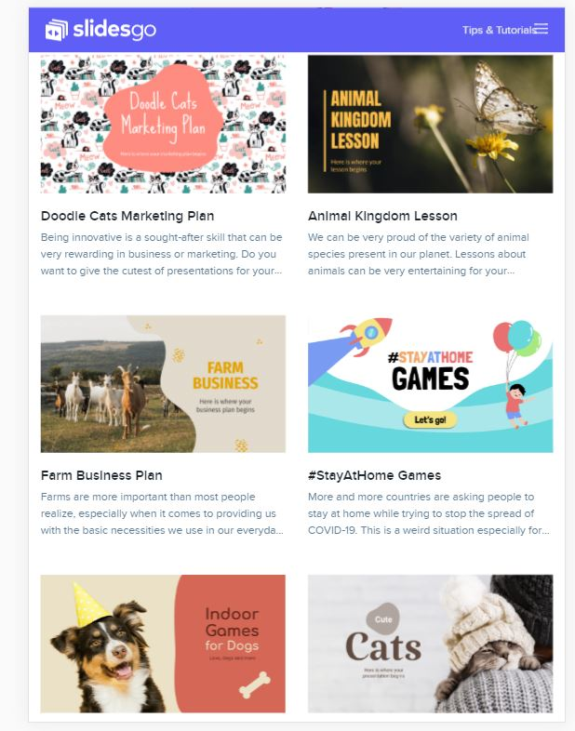
We will CrowdFund For Most Capital
GoFundMe campaigns should have us covered to start up, but our founders will bridge any shortage!

Slide 15
4
Implementation
Roll Out and Do This!

Slide 16
Targets by Month
Jul
Aug
Sep
Oct
Planning Complete
Volunteers Found, Intake Begins
First Location Full, Find New Location
Open New Location, Intake Until 0 Dogs are Euthanized in Philadelphia

Slide 17
Three Most Urgent Objectives
1
2
3
Gain 10+ volunteers available for a full time schedule, and 10+ volunteers available for a part-time schedule within first week of being fully crowdfunded
Obtain an average Yelp Review of 4.5+ stars with at least 50 reviews, and obtain 10,000+ followers/subscribers on social media within first 50 days
Rescue 100+ animals within the first 100 days

Slide 18
Marketing Plan Implementation
Action | Date | Duration | Cost | Responsibility
Targeted online media ads | August 1st | Approximately one month for 140k impressions | $1,000 | Charlie
Fliers in Target Neighborhoods | August 1st | Indefinite | $50 | Jody
Cold Call for Volunteers | August 2nd | Until enough volunteers found | $200 | Danielle
Host Rescue Event, Begin Intake | August 3rd | 10AM-9PM, until all Swag is given away | $500 | Danielle
Billboard | August 3rd | 3 Months | $6,000 | Jody

Slide 19
We Need At Least$7,750 for Q1
Operational Planning coming soon!
We should be highly Rated After Marketing Push
100%
Occupancy goal can be achieved quickly by coordinating with other rescues

Slide 20
Contingency Planning
Chances are, we’ll succeed
We may miss objectives; this is how we’ll respond
With thorough planning, a clear demonstrated need in Philly, and diligence, we will achieve our goals
Can’t find cheap rent?
Redevelop a property
Can’t fully crowdfund?
Founders will bridge
Social Media not growing?
Paid targeted ads

Slide 21
—Karen Devison
“Saving one dog will not change the world, but surely for that one dog, the world will change forever.”

Slide 22

Thank you
for your time!

Slide 23

Works Cited
Adoption Process. Philadelphia Animal Welfare Society. (2020, November 20). https://phillypaws.org/adopt/info/.
GoFundMe Search: animal rescue. (n.d.). https://www.gofundme.com/s?q=animal+rescue.
Hedgpeth, D. (2021, January 7). So many pets have been adopted during the pandemic that shelters are running out. The Washington Post. https://www.washingtonpost.com/dc-md-va/2021/01/06/animal-shelters-coronavirus-pandemic/.
How Much Does Facebook Advertising Cost in 2021? How Much Does Facebook Advertising Cost? | 2021 Pricing Guide. (n.d.). https://www.webfx.com/social-media/how-much-does-facebook-advertising-cost.html#:~:text=Facebook%20advertising%20costs%2C%20on%20average,%245.47%20per%20download%2C%20on%20average.
O'Kane, C. (2019, November 26). Trump signs bill making animal cruelty a federal felony. CBS News. https://www.cbsnews.com/news/animal-cruelty-felony-president-trump-signs-animal-cruelty-pact-act-bill-making-it-a-federal-felony-2019-11-25/.
Queiroz, R. (2021, May 7). How Much Does Billboard Advertising Cost? ⭐ DASH TWO. DASH TWO. https://dashtwo.com/blog/how-much-does-billboard-advertising-cost/#:~:text=The%20typical%20billboard%20sells%20for,rent%20for%20only%20%24600%2Fperiod.
Rossi More Articles November 21, J. (2017, November 21). 10 States Where Your Dog Might Be Banned. Showbiz Cheat Sheet. https://www.cheatsheet.com/culture/states-where-your-dog-might-banned.html/.
Sasko, C. (2019, December 16). How ACCT Philly's New Director Plans to Help the City's Underfunded Pet Shelter. Philadelphia Magazine. https://www.phillymag.com/news/2019/12/16/acct-philly-new-director/.
Sasko, C. (2019, January 10). Rhynhart Blasts Philly Animal Control for "Wasteful" Spending, Misuse of Grant Funds. Philadelphia Magazine. https://www.phillymag.com/news/2019/01/10/acct-rhynhart-report/.
Statistics & Reports - April 2019, April 2020, April 2021. ACCT Philly. (n.d.). http://www.acctphilly.org/about/statistics/.
Underwood, K. (2021, May 13). Animals Adopted During Pandemic Are Being Returned to Shelters. NBC Boston. https://www.nbcboston.com/news/clear-the-shelters/animals-adopted-during-pandemic-are-being-returned-to-shelters/2380084/.

